Slide 1
Course Name :
Object Oriented Programming Laboratory
Course No : CSE 2101
Project Name : Doctor Point
Submitted By :
Faisal Ahmed
Roll :1607048

Slide 2
Doctor point
Features :
Easy Communication between Doctor & Patient
Patient can easily find a doctor near his location
Telemedicine
Patient can judge a good doctor
Patient can easily find the Hospital Location & Emergency Contact
Doctor can post his blog in this apps

Slide 3
Doctor point
Introduction :
. A patient can easily find a doctor chamber or a hospital near his location.a patient can see
all the doctor location from his location by the google map .he can see all the doctor fee from his home and also the doctor’s educational background .so, a patient can easily judge a doctor that he is good or bad.telemedicine system helps both the doctor & patient .
There is a disease list in the apps.so , a patient can find his diseases specialized doctor for his treatment . Patient can see all the doctor fee (Vist) from his nearer location .so, Patient can sort the doctor’s fee and find a good doctor with low fees. This apps is useful for a young doctor to find patient .overwall the apps is useful for mankind .

Slide 4
Doctor point
OOP features used in this project :
1 . File
2 . Getter Setter
3 . Class and Object
4 . Friend function and operator Overloading
5 . Using getline after cin
6 . STL
7 . Inheitance
8 . Constructor
9 . Formatted IO
10 . Dynamic Memory allocation

Slide 5
Doctor point
Discussion:
C++ is a Object Oriented Programming Language .In this project most of The OOP features are used .This apps is useful for the mankind .this apps can help to easy communication between doctor and patient .Google map is used to find the nearest location .in this apps ,a doctor can create new account ,to see all the doctor list in a city ,write blog of his profile ,add Emergency number for teli medicare . Alos,the patient do this same work in this apps. this app can solve many social problem between the doctor & patient .

Slide 6
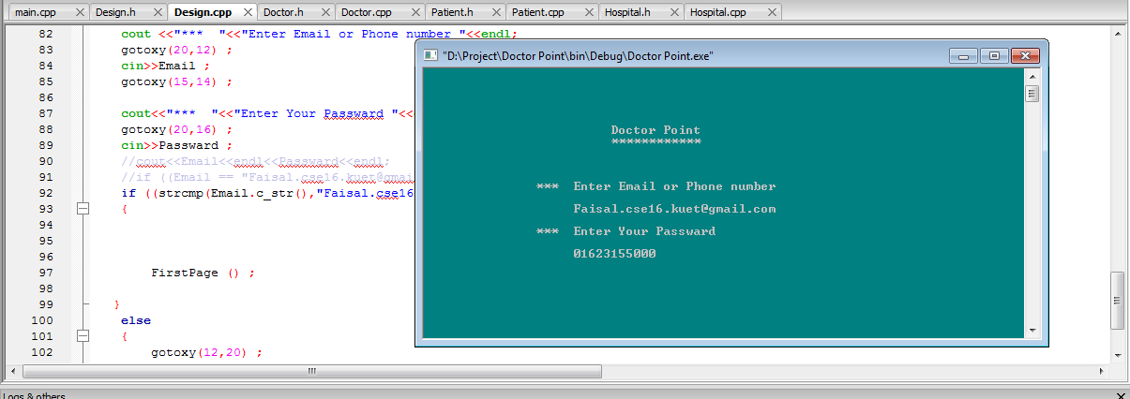
Doctor Point
Some Screenshot of this project

Slide 7
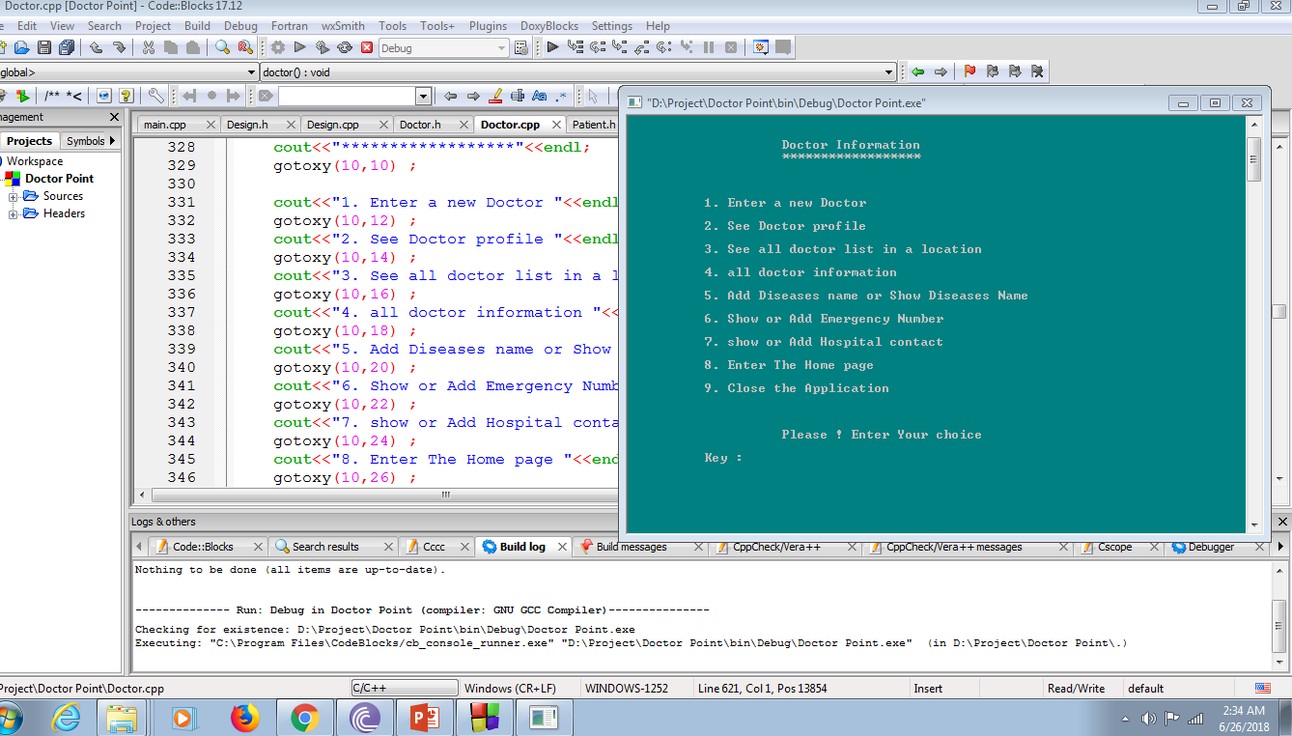
DOCTOR POINT

Slide 8
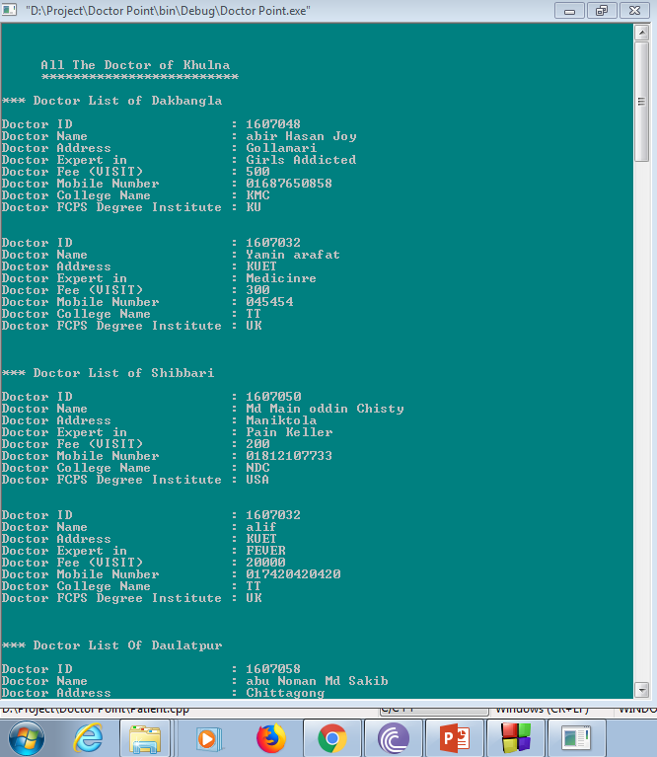
DOCTOR POINT

Slide 9
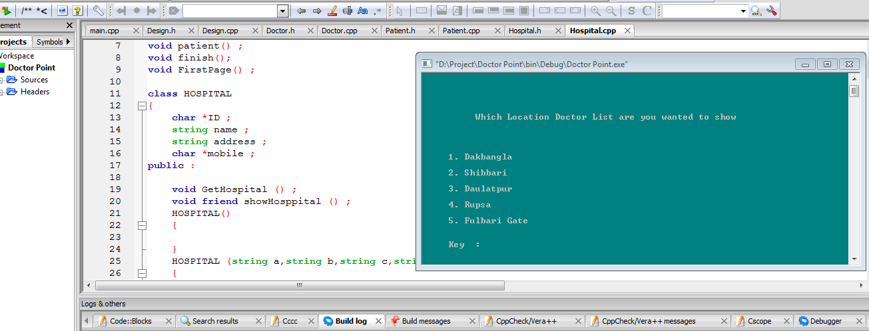
DOCTOR POINT

Slide 10
Thank You !
PROJECT LINK : https://drive.google.com/drive/folders/1csVMH0MIigo3V2n67MAka9DIK2Coibt2
Slide Link :
https://drive.google.com/open?id=1ZdEb3Kk6ukqpH6uoUc-WKU5qbuq82DwW

